Slide 1
Predicting and Analyzing Cyberbullying on Twitter Using Machine Learning Algorithms
TEAM SKYLINE
Anjani Prasad Gajula
Sri Vardhan Reddy Gankidi
Ajay Kumar Nagula
Sai Lokesh TIPPABHOTLA

Slide 2




Table Of Contents:
Problem Statement
Dataset Description
Software Components
Algorithms
Prediction of Cyberbullying Tweets by Type
Summary

Slide 3
Problem Statement:
Cyberbullying refers to a form of cybercrime where individuals use digital platforms such as social media and gaming communities to bully others. This involves sharing harmful, negative, false or personal information about the victim with the intention to degrade, threaten, humiliate or embarrass them online. This is a very serious issue as it can have a significant impact on the victim's mental health, and in some cases, it may even affect their entire life. Victims of cyberbullying may become scared, threatened, antisocial, and even depressed, leading them to contemplate suicide.
Twitter is one of the most prominent social media platforms where cyberbullying occurs. In this project, our goal is to detect cyberbullying-related posts, chats, and comments from Twitter's dataset. By successfully accomplishing this project, we can identify different types of cyberbullying and classify the texts according to the type of cyberbullying involved.

Slide 4

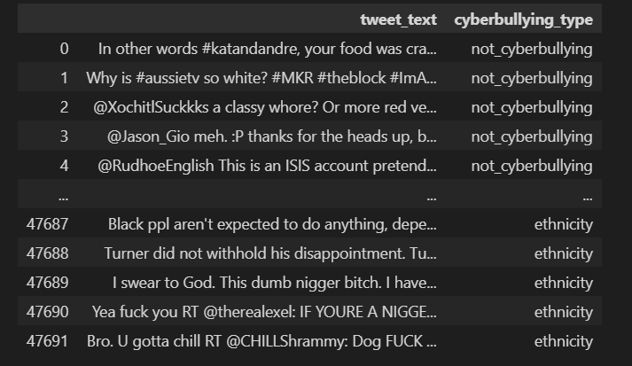
Dataset Description:
The data set, named "cyberbullying_tweets.csv," was obtained from Kaggle.
As shown in the slide, the data set contains only two columns: "tweet text," which contains the text comments, and "cyberbullying_type," which provides the label for each comment.

Slide 5
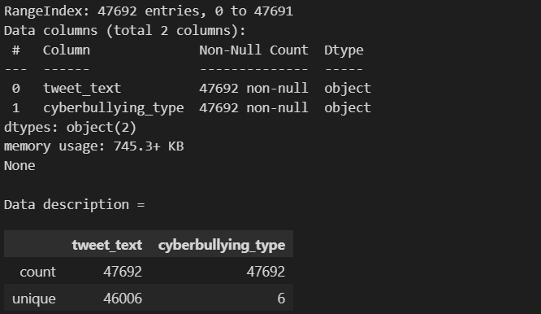
Through data info, we can determine whether the dataset contains any missing values.
Based on the code, it appears that there are no null values in the dataset. Additionally, the data description reveals that there are six distinct types of cyberbullying texts present within the dataset.

Slide 6
Software Components:
Operating Systems : Windows
Coding Language : Python
Tool : Visual Studio Code
Packages : Pandas - 2.0.1, Scikit-learn - 1.2.2

Slide 7
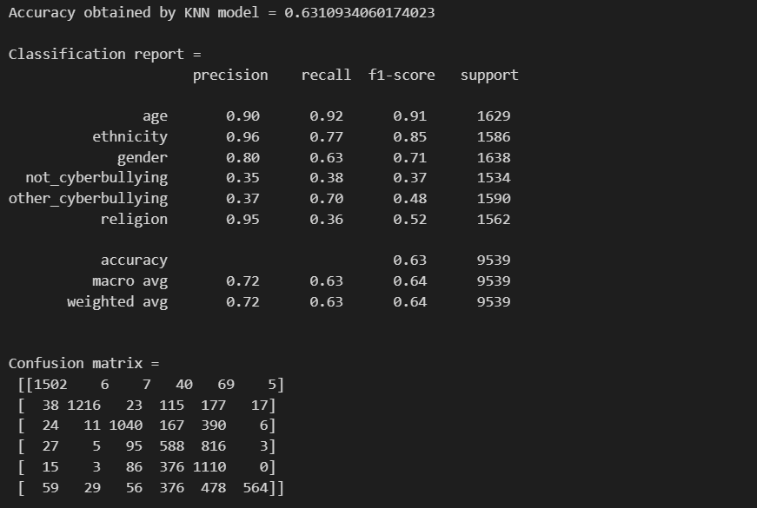
ALGORITHMS
KNearest Neighbor's Classifier
The k-Nearest Neighbors (k-NN) classifier is a type of machine learning algorithm that is used for classification tasks. It works by identifying the k-nearest data points to the test data point, and assigning the test data point to the class that is most common among its k-nearest neighbors. In other words, the k-NN classifier classifies a data point based on the class of its closest neighbors in the feature space. The value of k is usually determined by cross-validation and tuning to optimize model performance. Here is the detailed report

Slide 8
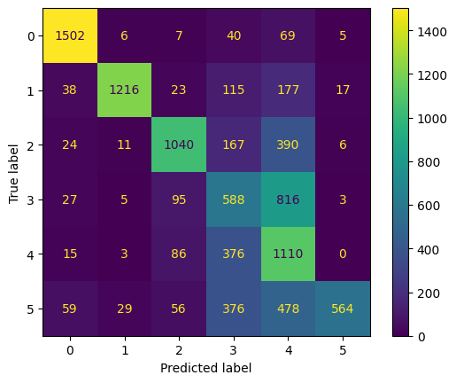
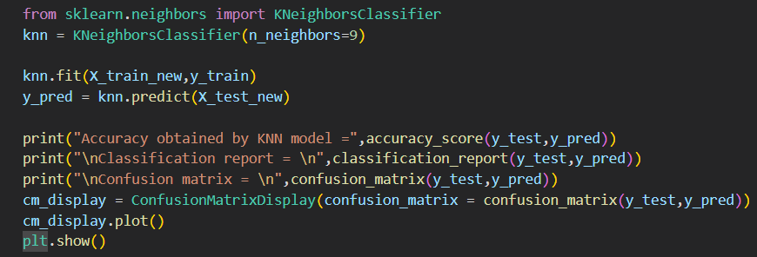

Slide 9
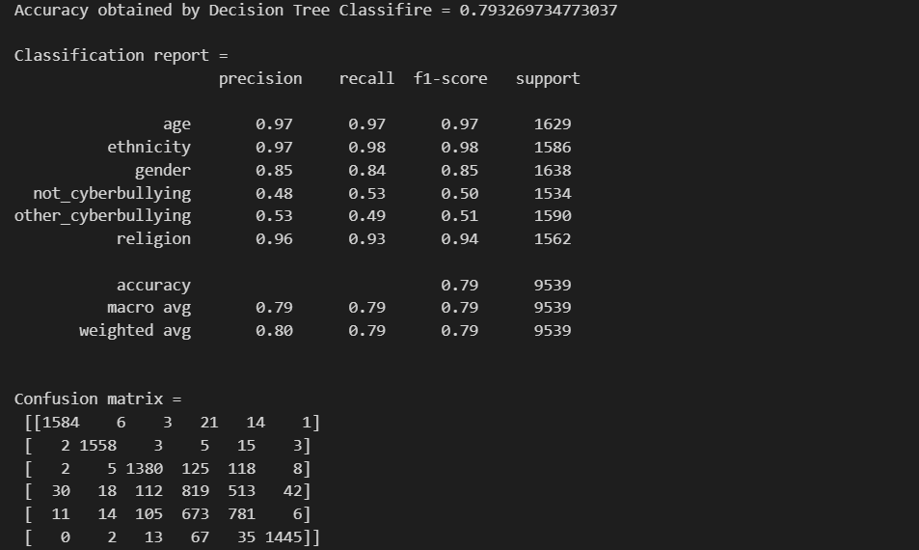
Decision Tree Classifier
The Decision Tree Classifier is a type of machine learning algorithm that is used for classification tasks. It works by constructing a tree-like model of decisions and their possible consequences. The decision tree is built by recursively splitting the dataset into subsets based on the values of the input variables. At each split, the algorithm selects the input variable that provides the most information gain, i.e. the variable that best separates the different classes. The tree can then be used to classify new data points by following the path from the root node to a leaf node, where the leaf node represents the class label. Decision trees are interpretable, easy to understand and implement, and can handle both categorical and numerical data. However, they may suffer from overfitting and instability, especially when the tree is deep or complex.

Slide 10
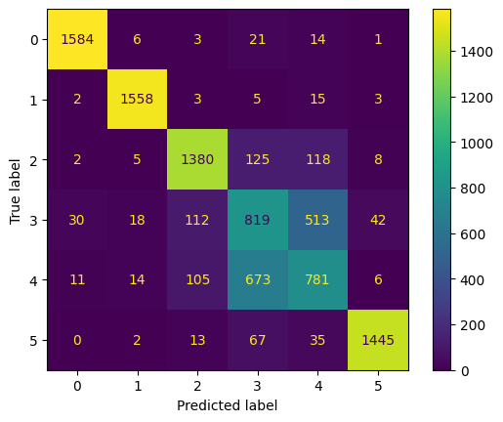
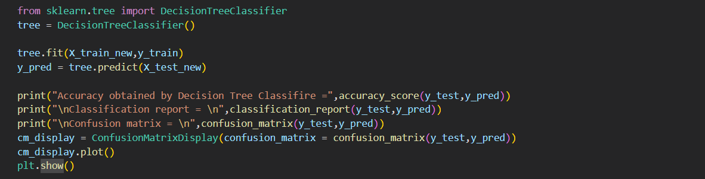

Slide 11
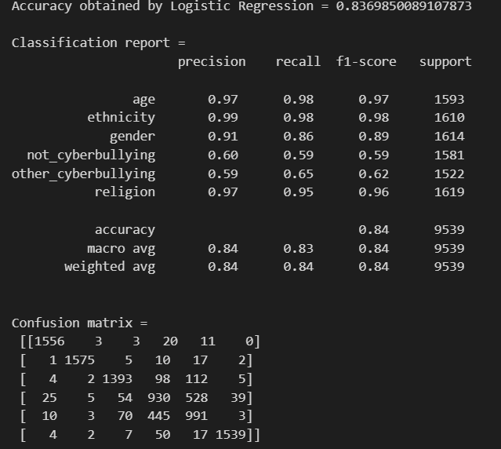
Logistic Regression
It is a statistical machine learning algorithm used for classification tasks. It models the probability of a binary or categorical dependent variable based on one or more independent variables, by applying a logistic function to the linear combination of the input variables. The logistic function outputs a value between 0 and 1, which represents the predicted probability of the positive class. The algorithm learns the optimal values of the coefficients (weights) for each input variable by minimizing a cost function, typically using gradient descent or other optimization methods. Logistic Regression is widely used in many fields, such as marketing, finance, healthcare, and social sciences, where binary or multi-class classification problems are common.

Slide 12
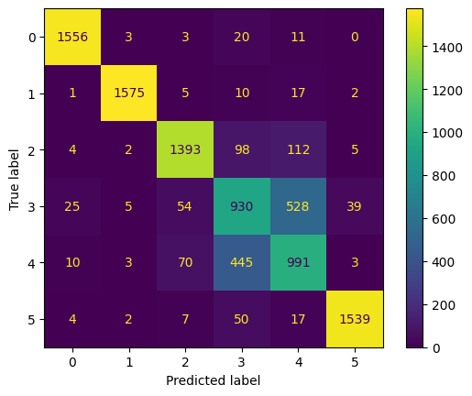
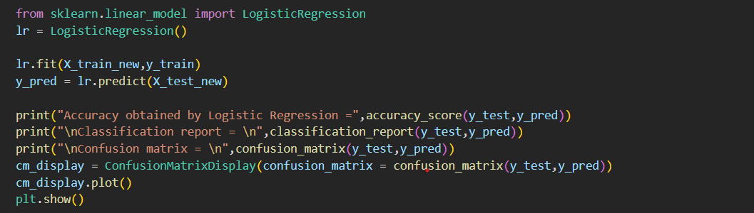

Slide 13
Prediction of Cyberbullying Tweets by Type
This code loads a dataset of cyberbullying tweets and prompts the user to input a type of tweet to predict. It filters the dataset based on the user input and then prompts the user to input the number of tweets to display. The code defines the features and labels for the selected tweets and prints the tweet texts. The X variable contains the tweet text features and the y variable contains the tweet type labels. This code allows the user to interactively explore the dataset and select a specific category of tweets to analyze. It is useful for analyzing the prevalence and characteristics of cyberbullying on social media platforms.

Slide 14
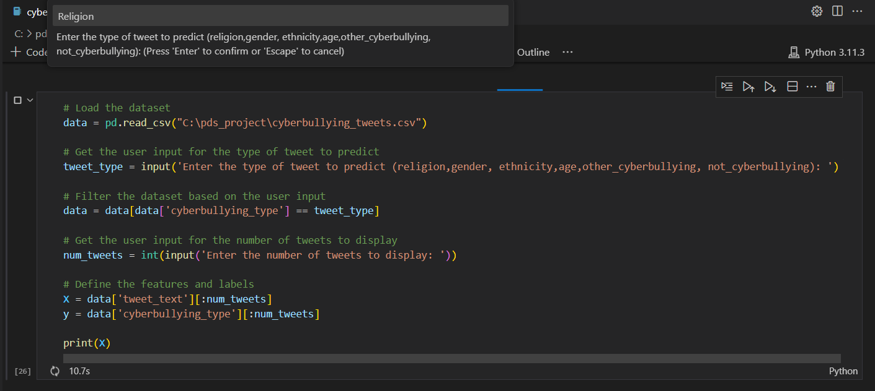
Input 1- Type of Tweet to predict

Slide 15
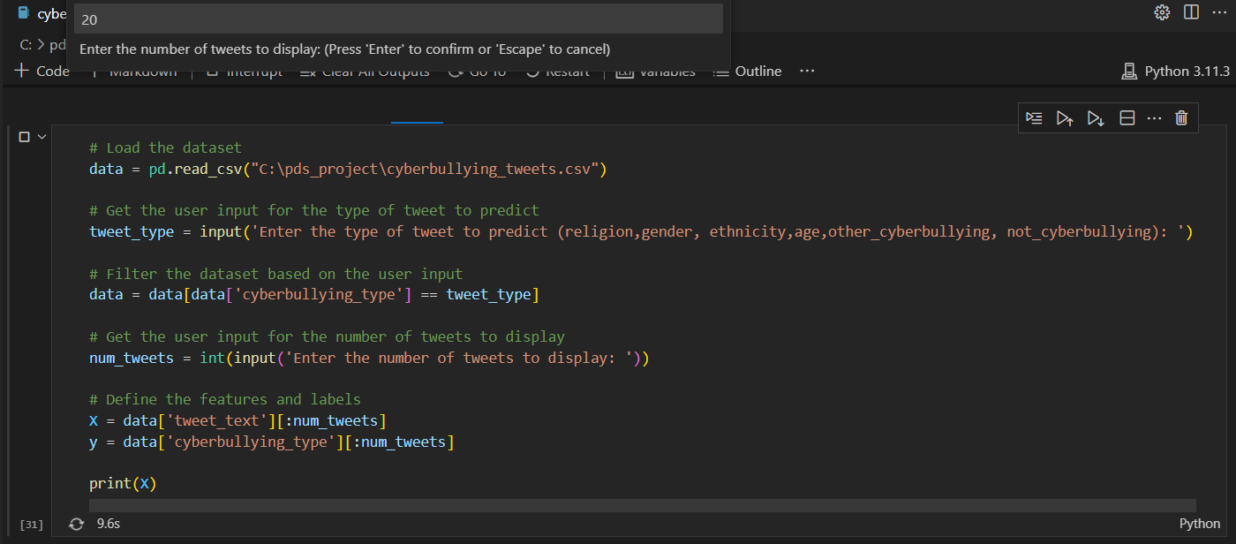
Input 2: Number Of Tweets To Display

Slide 16
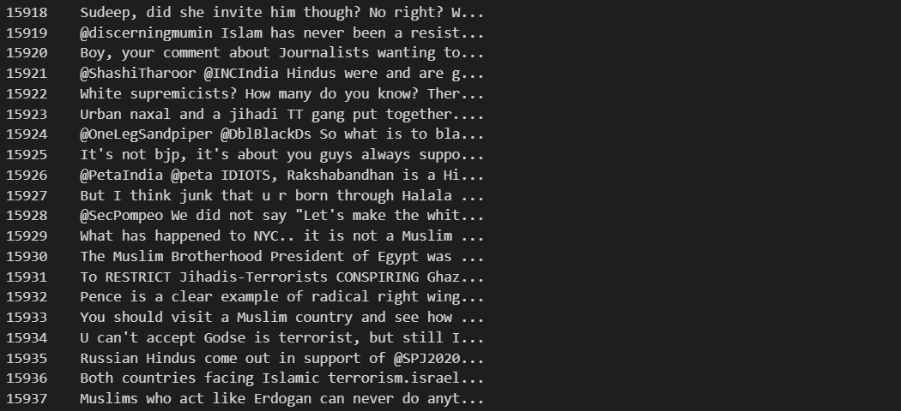
Output

Slide 17
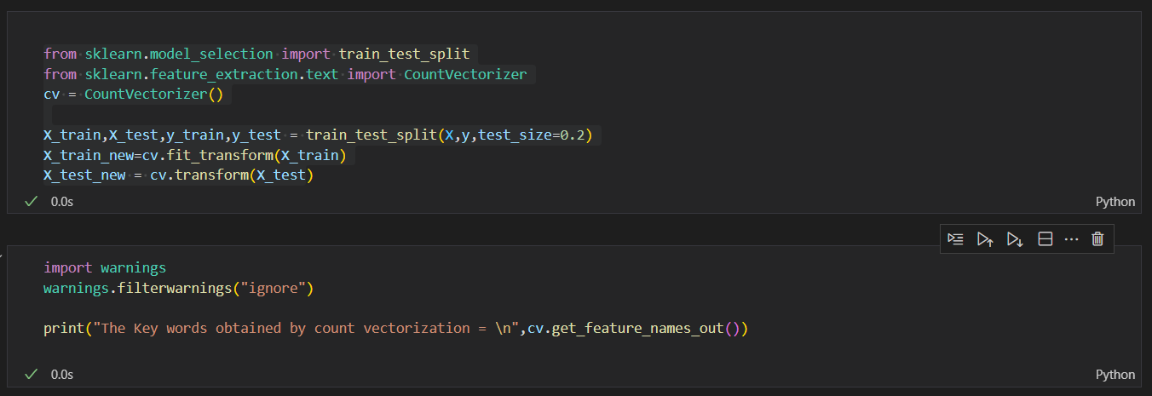
Splitting Data and Performing Count Vectorization on Cyberbullying Tweets to Obtain Key Words
This code uses the scikit-learn library in Python to split a dataset into training and testing sets, extract features from the textual data using Count Vectorizer, and print the key words obtained by the vectorization. The dataset is split into training and testing sets using the train_test_split function from the scikit-learn library. The Count Vectorizer function is used to extract features from the training and testing datasets. The get_feature_names_out function is used to print the key words obtained by the Count Vectorizer.

Slide 18
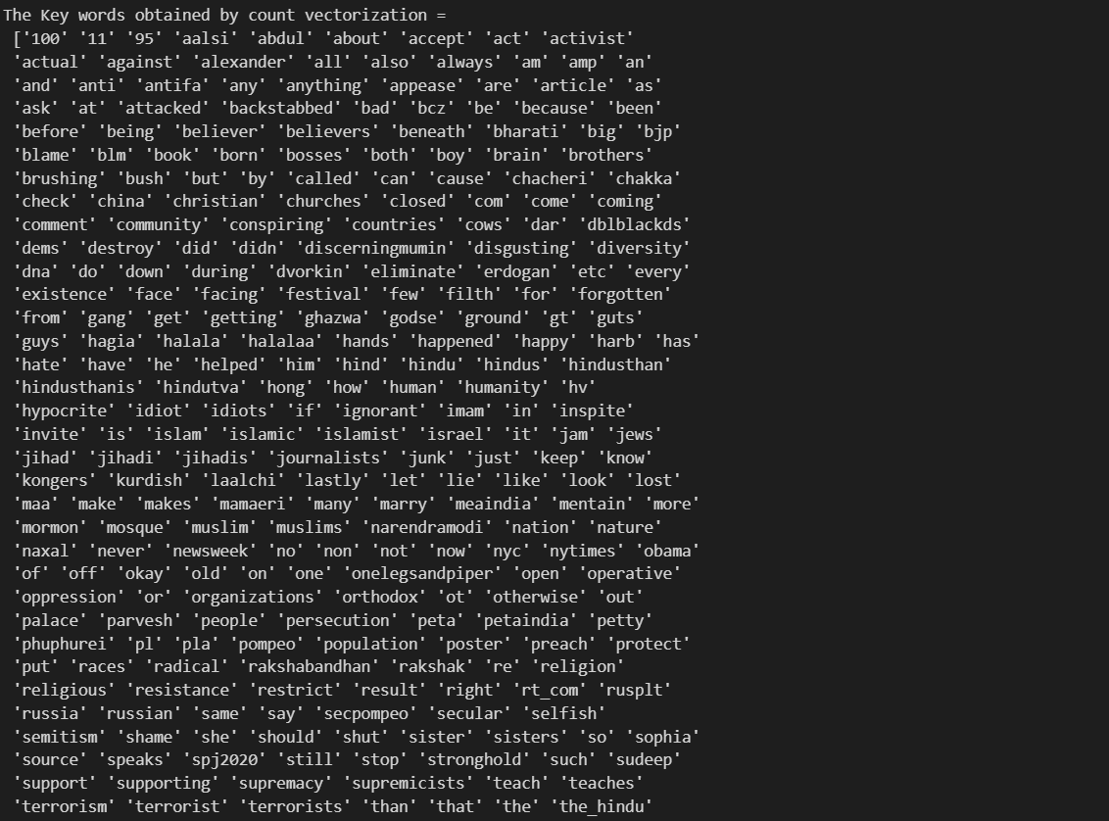
Output:

Slide 19
Summary:
Execution time for the analysis is taking more time than expected depending upon the algorithm used.
Out of these algorithms based on the dataset we see only the KNN model gives 61.3% accuracy, but rest all gives more that 75% accuracy. Logistic regression is the best as it gives 83.19%.
So, we can conclude that logistic regression is the best choice for predicting the fake tweets. The classification report is given in a tabular way in next slide.
To reduce complexity and minimize the size of the X array, it is necessary to decrease the number of features. This can be achieved by using Natural Language Processing (NLP) techniques, which help to enhance text processing. The NLTK (Natural Language Toolkit) can be utilized to eliminate extraneous words from the dataset, thereby improving the accuracy of model evaluation. This will ultimately lead to a more effective and accurate model.

Slide 20
Thank You

